Slide 1
Introduction to
Leahy Consulting

Slide 2
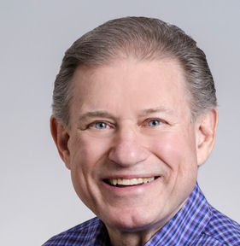

Leahy Consulting, Inc.
39th year in business
29 years Macola experience
Specialize in manufacturing
& distribution
11 employees - Cincinnati OH
Mike Leahy

Slide 3
What Macola services do we offer?
- Making better use of your Macola
investment
- Streamlining your business workflow
- Technical support
- Custom programming to improve your
Macola experience

Slide 4

Our PULSE suite of add-on software improves your Macola experience
- PULSE Dashboard
- PULSE Archive
- PULSE Lockbox
- PULSE eCommerce
- PULSE Utilities (14 utilities)

Slide 5
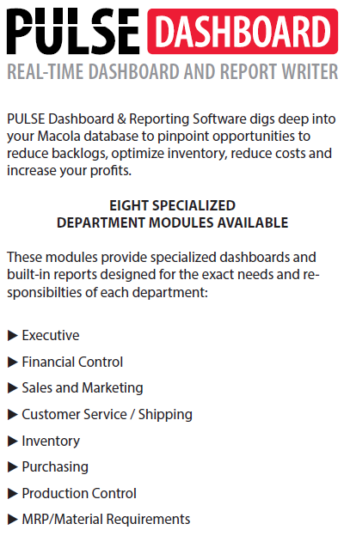
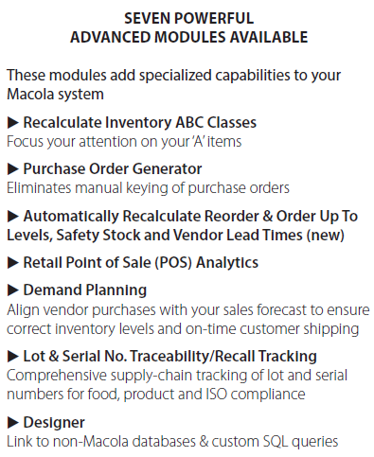

Slide 6


Slide 7
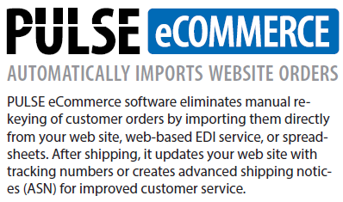

Slide 8
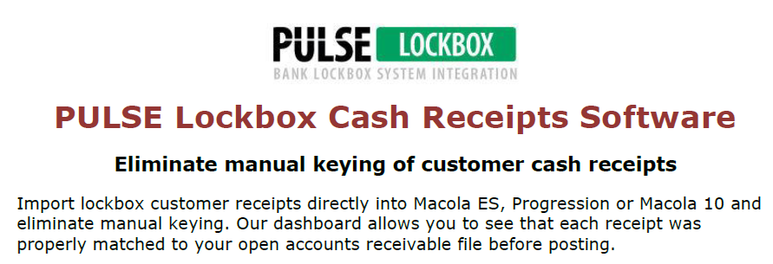

Slide 9
